Slide 1


Slide 2
Better late than never
Scalar Type Hints in PHP 7

Slide 3
PHP types
Null – the value “null”
Boolean – the values “true” or “false”
Integer – a signed 64-bit integer
Float – 64-bit IEEE 754 binary floating-point
String – sequence of bytes of arbitrary length
Resource – Ph'nglui mglw'nafh Cthulhu R'lyeh wgah'nagl fhtagn
Object – an instance of a class
Array – an ordered map of key/value pairs

Slide 4
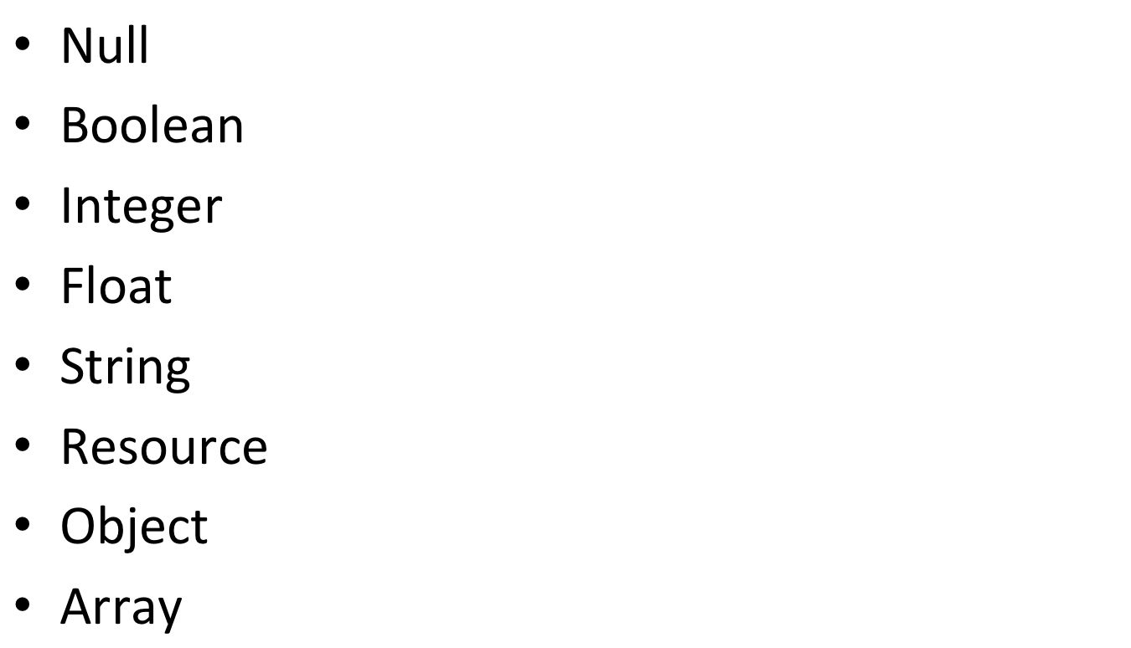
PHP types
Scalar types
Complex types

Slide 5
The PHP way
Dynamically-typed
  Any variable can contain any type of value
  Types of variables can change
  No type declarations in source code
  $a = 12; // fine
  $a = true; // also fine
  versus
  int a = 12; // fine
  a = true; // error!

Slide 6
The PHP way
Weakly-typed
  Implicit conversions between types
  // string
  $offset = $_GET['offset'];
  // intdiv() converts $offset to integer
  $page_count = intdiv($offset, RESULTS_PER_PAGE);
  // concatenating converts integers to strings
  echo "Page " . $offset . " of " . $page_count;

Slide 7
The PHP way
Benefits
  Don’t need to specify types in source code
  Don’t need to explicitly convert input
    Useful on the web where most incoming data (HTTP) will be strings
  Don’t need to explicitly convert output
    Useful on the web where most output (HTML) will be strings
  These combined mean very quick prototyping!

Slide 8
The PHP way
Downsides
  Implicit conversions hide errors in code
    NULL and FALSE often represent errors, but PHP will happily convert them to zero or an empty string
    // ¯\_(ツ)_/¯
    password_hash($_POST["psaswrod"], PASSWORD_BCRYPT);
    Boolean and string parameters accept almost anything, good luck spotting if you’ve got the order wrong
    base_convert(10, $decimal, 2);

Slide 9
The PHP way
Downsides
  Implicit conversions silently discard data
    sin("123abc") // works!
    Spot the bug:
    imageFilledRectangle($image, $segment->x - 1.5, $segment->y - 1.5, $segment->x + 1.5, $segment->y + 1.5, $colour);

Slide 10
The PHP way
Downsides
  Implicit conversions silently discard data
    sin("123abc") // works!
    Spot the bug:
    imageFilledRectangle($image, $segment->x - 1.5, $segment->y - 1.5, $segment->x + 1.5, $segment->y + 1.5, $colour);
Implicit truncation

Slide 11
The PHP way
Downsides
  Even when implicit conversions make noise, the program keeps going
    // Returns NULL, produces E_WARNING
    $key = random_bytes("'256");
    // This line still gets executed
    $data = mcrypt_encrypt($algo, $key, $data);
    // (As does this one, incidentally)
    file_put_contents('encrypted', $data);

Slide 12
The PHP way
Downsides
  Type errors aren’t spotted until the last minute
  class MyObject {
  public function __construct($myDependency) {
  $this->myDependency = $myDependency;
  }
  }
  // Ticking time bomb!
  $object = new MyObject(null);
  Good luck figuring out where the error originated

Slide 13
The PHP way
Downsides
  Without types specified in source code, function signatures aren’t very helpful
    Interfaces are very weak contracts
    How do we use this function?
    function renderLetterPreviews($letter)

Slide 14
The PHP way
Can we eliminate most of these problems in some way?

Slide 15
The PHP way
Can we eliminate most of these problems in some way? Yes!
  Conversion of PHP “errors” to Exceptions
    E_NOTICE and E_WARNING errors sometimes produced by implicit type conversions, now stop execution if not handled
    // Now throws an exception!
    sin("123abc");
    But most problems don’t trigger these errors anyway
    Error handlers are global and break other code!

Slide 16
The PHP way
Can we eliminate most of these problems in some way? Yes!
  Docblocks
    Provide information the function signature doesn’t
    /**
    * @param $letter Letter
    * @return string[]
    */
    function renderLetterPreviews($letter)
    IDEs can do type checking

Slide 17
The PHP way
Can we eliminate most of these problems in some way? Yes!
  Docblocks
    Not all errors can be caught ahead-of-time
    Not everyone uses IDEs!
    Docblocks can lie without consequences
    Ugly and verbose
    Why doesn’t the language itself have this?

Slide 18
The PHP way
Can we eliminate most of these problems in some way? Yes!
  Type hints
    Allow us to avoid or control implicit conversions!
    Allow us to catch type errors before values are actually used
    Give us much more information in our function type signatures (and give interfaces teeth)
    The best solution!
    Can’t fix PHP’s operators, though

Slide 19
Type hints
Class/interfaces since PHP 5.0 (2004)
function renderLetterPreviews(Letter $letter)
Arrays since PHP 5.1 (2005)
function sum(array $numbers)
Callables in PHP 5.4 (2012)
function map(callable $functor, array $items)

Slide 20
Type hints
Ensure that function/method parameters are the correct type at runtime
Widely used and very useful
Not really “hints”, given that the runtime actually enforces them, but oh well

Slide 21

Type hints
Ensure that function/method parameters are the correct type at runtime
Widely used and very useful
Not really “hints”, given that the runtime actually enforces them, but oh well
Declarations! Type declarations!

Slide 22
Type hints
Can’t specify what a function/method returns
No support for the scalar types

Slide 23
Type hints
Can’t specify what a function/method returns
No support for the scalar types
Can we change this?

Slide 24
So you’ve decided you want to add a feature to PHP

Slide 25
How features are added to PHP
Post-2009: Request for Comments (RFC) process
Prepare a proposal with a patch
Submit proposal to internals mailing list
At least 2 week discussion period
Amend proposal if necessary
Proposal is voted on by core contributors
If >2/3 votes are Yes, the proposal is adopted

Slide 26
Why people don’t add features to PHP
Large investment of time and effort
D.I.Y. implementation
  PHP is written in poorly-documented C
D.I.Y. proposal-writing
D.I.Y. dealing with mailing list

Slide 27


Why people don’t add features to PHP
Large investment of time and effort
D.I.Y. implementation
  PHP is written in poorly-documented C
D.I.Y. proposal-writing
D.I.Y. dealing with mailing list

Slide 28
Early attempts
A lot of people want scalar type hints – it’s been proposed almost every year
Notes:
Supposedly PHP 5.3 had it at one point and it was reverted

Slide 29
Early attempts
Fundamental problem: should scalar type hints be “weak” or “strict”?
Weak
  Implicit type conversion (with all the problems)
  PHP’s built-in functions already do this
Strict
  Only exact type match allowed (no conversion!)
  Non-scalar type hints already do this
  Not very “PHP”

Slide 30
Early attempts
Fundamental problem: should scalar type hints be “weak” or “strict”?
Weak
  sin("12"); // Works
Strict
  sin("12"); // ERROR!

Slide 31
My first attempt
2012 RFC by Anthony Ferrara: “Scalar Type Hinting with Cast”
Proposed five new type hints: int, float, string, bool, resource
function add(int $a, int $b)
Same implicit conversion behaviour as built-in PHP functions
Withdrawn in 2013 after he quit PHP internals

Slide 32
My first attempt
July 2014, I decided to revive Anthony’s RFC
Tried to bridge weak/strong divide with a compromise
Changed the RFC to have stricter weak type hints
Got rid of resource

Slide 33
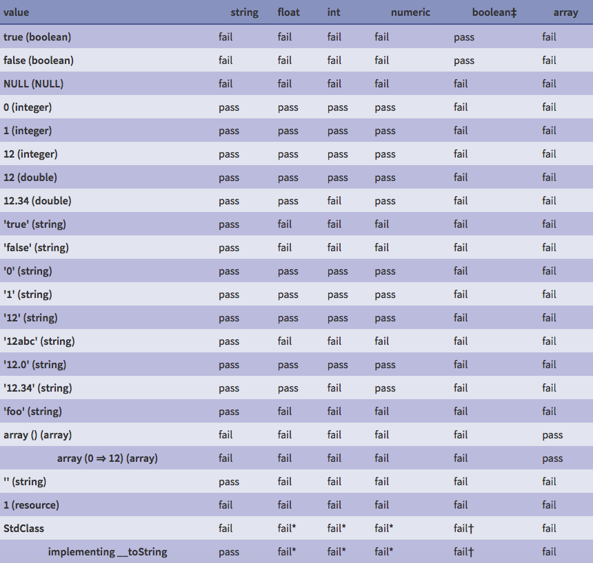

Slide 34
My first attempt: result
“Compromise” pleased neither side
Fans of weak types didn’t like the stricter rules
Fans of strict types wanted actual strict types
Nobody wants a new set of conversion rules!
Inconsistent with built-in functions

Slide 35
My first attempt: result
“Compromise” pleased neither side
Fans of weak types didn’t like the stricter rules
Fans of strict types wanted actual strict types
Nobody wants a new set of conversion rules!
Inconsistent with built-in functions
Proposal withdrawn

Slide 36
My second attempt
December 2014, I made a new proposal
Picked a side: Weak types
Four new hints: int, float, string, bool
Exactly the same conversion rules as built-in PHP functions
No massive conversion table

Slide 37
My second attempt: result
Fans of weak types loved it
Fans of strict types did not
I thought it might narrowly be able to win, but wasn’t worth it

Slide 38
My second attempt: result
Fans of weak types loved it
Fans of strict types did not
I thought it might narrowly be able to win, but wasn’t worth it
Voting postponed

Slide 39

A solution?
New suggestion from 2nd attempt discussions:

Slide 40
A solution?
Strict type syntax:
function foo_strict(int $bar);
// Error!
foo_strict("123");
Weak type syntax:
function foo_weak((int) $bar);
// OK!
foo_weak("123");

Slide 41
A solution? Not quite.
Inconsistent with built-in functions (they’re always weak)
At the mercy of the API author!
Weak type fans must deal with strict type APIs
Strict type fans must deal with weak type APIs
A function could use both at the same time 😨
Two different sets of rules to worry about!

Slide 42
Epiphany!
What if we only have one set of scalar type hints, and choose whether we want weak or strict typing on a file-by-file basis?

Slide 43
Epiphany!
<?php
// No error!
var_dump(sin("12"));
<?php declare(strict_types=1);
// Error!
var_dump(sin("12"));

Slide 44
Epiphany!
Every function call and return statement will follow the rules you prefer
No fragmentation
Even affects built-in PHP functions!
Can add type hints to existing APIs without breaking things
A workable proposal?

Slide 45
Third attempt: results
January 2015, I changed the RFC to do this
The most discussed, most controversial RFC in PHP history
Spawned two competing RFCs, a successor RFC, and a lot of drama
I quit PHP mid-vote – Anthony finished the job
However, compromise was successful

Slide 46

Third attempt: results
January 2015, I changed the RFC to do this
The most discussed, most controversial RFC in PHP history
Spawned two competing RFCs, a successor RFC, and a lot of drama
I quit PHP mid-vote – Anthony finished the job
However, compromise was successful

Slide 47
Scalar Type Hints in PHP 7
int, float, string, bool
Work as both parameter and return type hints
function add(int $a, int $b): int;
Support nullable parameters
function greet(string $name = null);
Handle errors just like other type hints:
takes_object(null); // TypeError
takes_int(new StdClass); // TypeError

Slide 48
Type conversion rules
Weak mode
  Same as built-in PHP functions, except for null
 | int | float | string | bool
int | yes | yes | yes | yes
float | if in range | yes | yes | yes
string | if numeric | if numeric | yes | yes
bool | yes | yes | yes | yes
null | no | no | no | no
object | no | no | __toString | no

Slide 49
Type conversion rules
Strict mode
  “Widening” (int->float) allowed
 | int | float | string | bool
int | yes | yes | no | no
float | no | yes | no | no
string | no | no | yes | no
bool | no | no | no | yes
null | no | no | no | no
object | no | no | no | no

Slide 50
declare(strict_types=1);
Per-file declaration
Put it at the top of the file
Affects all calls and return statements in file
Has no effect on calls and returns in other files
Files without declaration use weak mode
Bonus! Strict mode makes built-in functions throw exceptions on errors

Slide 51
declare(strict_types=1);
Functions
  always get the parameter type they ask for, and
  always produce the type they claim to return,
  no matter what modes are in use

Slide 52
Declaration scope
Caller decides parameter type checking mode
<?php
foo("bar"); // weakly type-checked function call
function foobar() {
foo("bar"); // weakly type-checked function call
}
class baz {
function foobar() {
foo("bar"); // weakly type-checked function call
}
}

Slide 53
Declaration scope
Caller decides parameter type checking mode
<?php
declare(strict_types=1);
foo("bar"); // strictly type-checked function call
function foobar() {
foo("bar"); // strictly type-checked function call
}
class baz {
function foobar() {
foo("bar"); // strictly type-checked function call
}
}

Slide 54
Declaration scope
Callee decides return type checking mode
<?php
function foobar(): int {
return 1.0; // weakly type-checked return
}
class baz {
function foobar(): int {
return 1.0; // weakly type-checked return
}
}

Slide 55
Declaration scope
Callee decides return type checking mode
<?php
declare(strict_types=1);
function foobar(): int {
return 1.0; // strictly type-checked return
}
class baz {
function foobar(): int {
return 1.0; // strictly type-checked return
}
}

Slide 56
Declaration scope
-- A.php --
<?php declare(strict_types=1);
function add(float $a, float $b): float {
return $a + $b;
}
-- B.php --
<?php
include_once 'A.php';
// No error!
add("123", true);

Slide 57
Built-in functions throw exceptions
<?php // without strict mode
// E_WARNING: file_get_contents() expects parameter 1 ...
// Returns null
$file = file_get_contents([]);
versus
<?php declare(strict_types=1);
// TypeError: file_get_contents() expects parameter 1 ...
$file = file_get_contents([]);

Slide 58
What we don’t yet have
Nullable or union types
  No way to say “this returns an integer or null” for now (?int in Hack)
  Can’t have parameters allowing one type or the other (int|string has been proposed)
Generics or “array of …” types
callable parameter/return type hints
void, number, object

Slide 59
Interesting future stuff
Type-checkers for PHP that use (scalar) type hints
  Anthony Ferrara’s Tuli
  Rasmus Lerdorf’s Phan (proof of concept)
  Some IDEs

Slide 60
Using type hints in your code
Runtime support
  PHP 7.0 has support, ETA November 2015
  HHVM doesn’t yet support (Hack exists, though)

Slide 61
Adding type hints to existing code
Iterate: Add types to file, test, go to next file
Don’t need to do this at the same time as enabling strict types
But it’s easier to spot errors if you do
Can mix and match strict/weak
Avoid casts like (int), which silently discard invalid data
  Use filter_var or theodorejb/polycast

Slide 62
Adding type hints to existing code
Is your database producing correct types?
  MySQL “emulated prepares” make all data be a string
  SQLite is dynamically-typed

Slide 63
Summary
PHP’s weak, dynamic typing allows for rapid development, but creates bugs
Use type hints to avoid bugs and better document your code

Slide 64
Any Questions?

Slide 65
Thank you for your time!
joind.in/15430
@AndreaFaulds
ajf.me
Feedback

